Slide 1

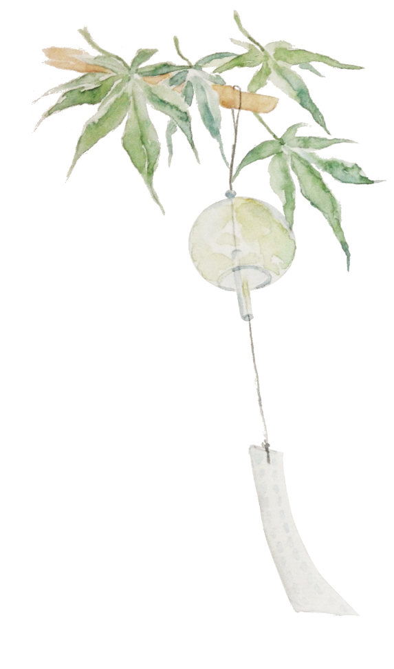
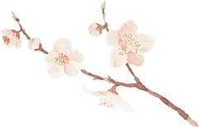
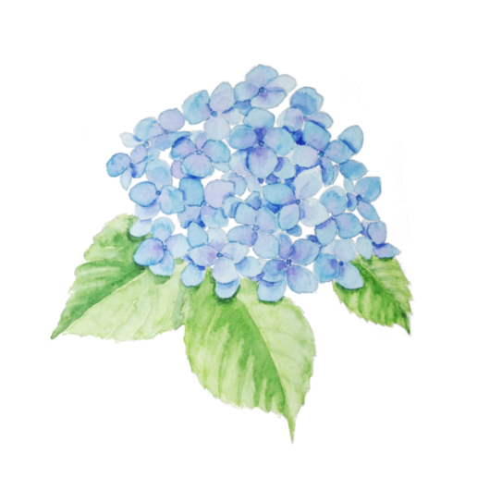
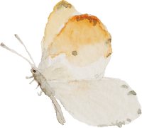
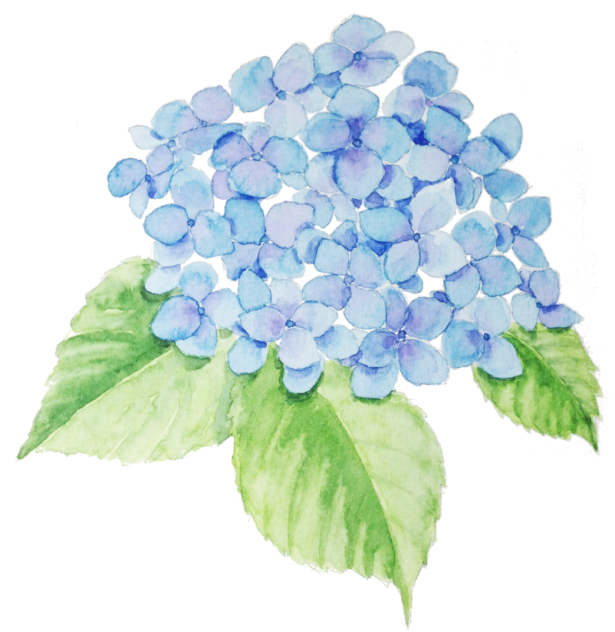
Food

Slide 2
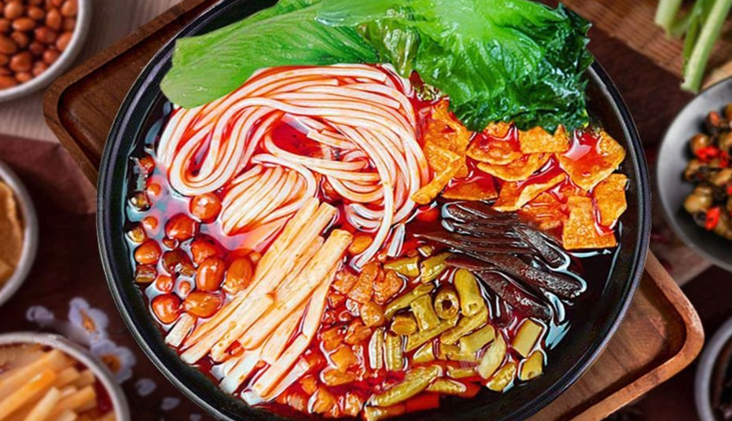
River snail noodles(螺蛳粉)
River snail noodles are Guangxi's specialty, the most popular food in Guangxi, features in extremely spicy.
It usually does not contain snail meat, but it is instead served with pickled bamboo shoot, pickled green beans, shredded wood ear, fu zhu, fresh green vegetables, peanuts, and chili oil added to the soup.
The stock that forms the soup is made by stewing river snails and pork bones for several hours with black cardamom, fennel seed, dried tangerine peel, cassia bark, cloves, white pepper, bay leaf, licorice root, sand ginger, and star anise.

Slide 3
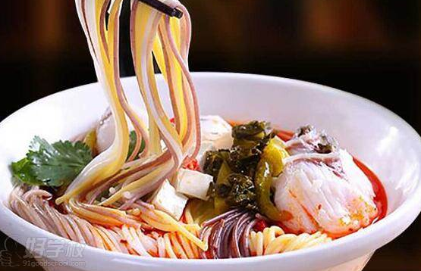
Five Grain fish noodles(五谷鱼粉)
Five grain fish noodles are my favorite noodles.
It consists of noodles, tofu, fish, vegetable.
Noodles are determined by their soup.

Slide 4
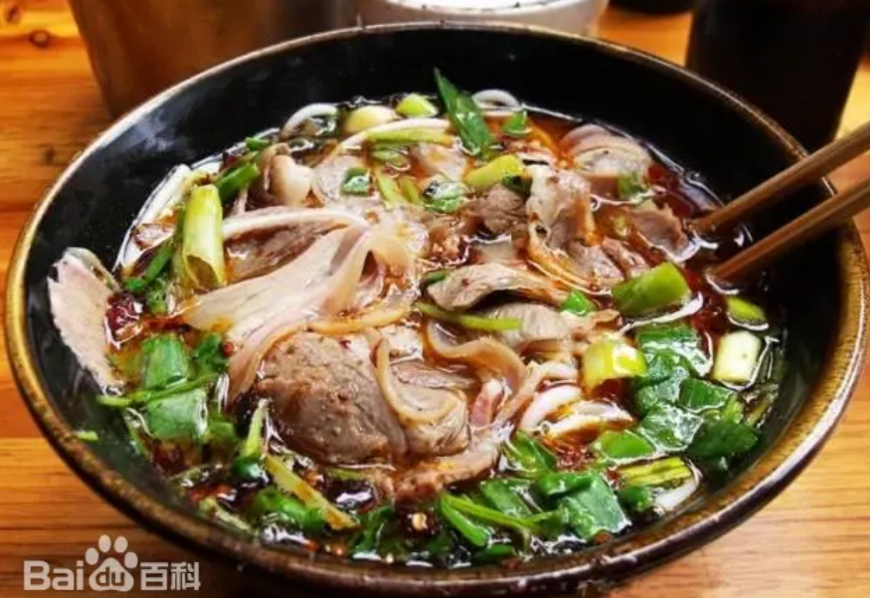
Mutton Rice Noodle(羊肉粉)
It’s my best option for not having an appetite.
It consists of mutton, rice noodles, secret sauce, pepper, garlic, perilla, chili oil, scallions, coriander.

Slide 5
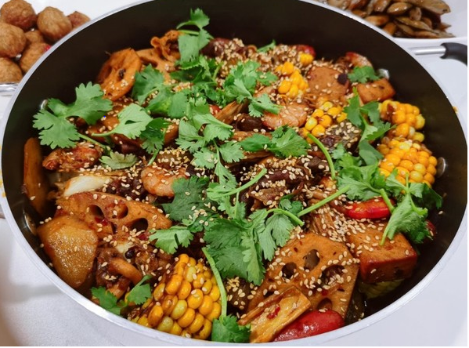
Mala Dry Pot(麻辣香锅)
麻辣香锅
Highly recommended, howerver can easily get bored after eating too freaquntly.
Mala Dry Pot and Spicy Hot Pot(麻辣烫) are very popular in China.
It’s a little bit more expensive than other fast food.Better to with a cold drink when having it.

Slide 6

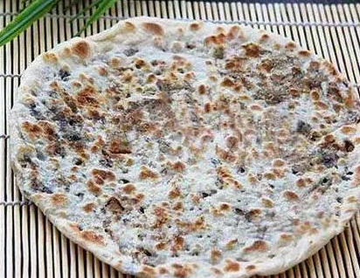
May dish buckle meat pancake(梅菜扣肉饼)
Crispy on the outside and moist and flavorful on the inside.
My favorite pancake.

Slide 7
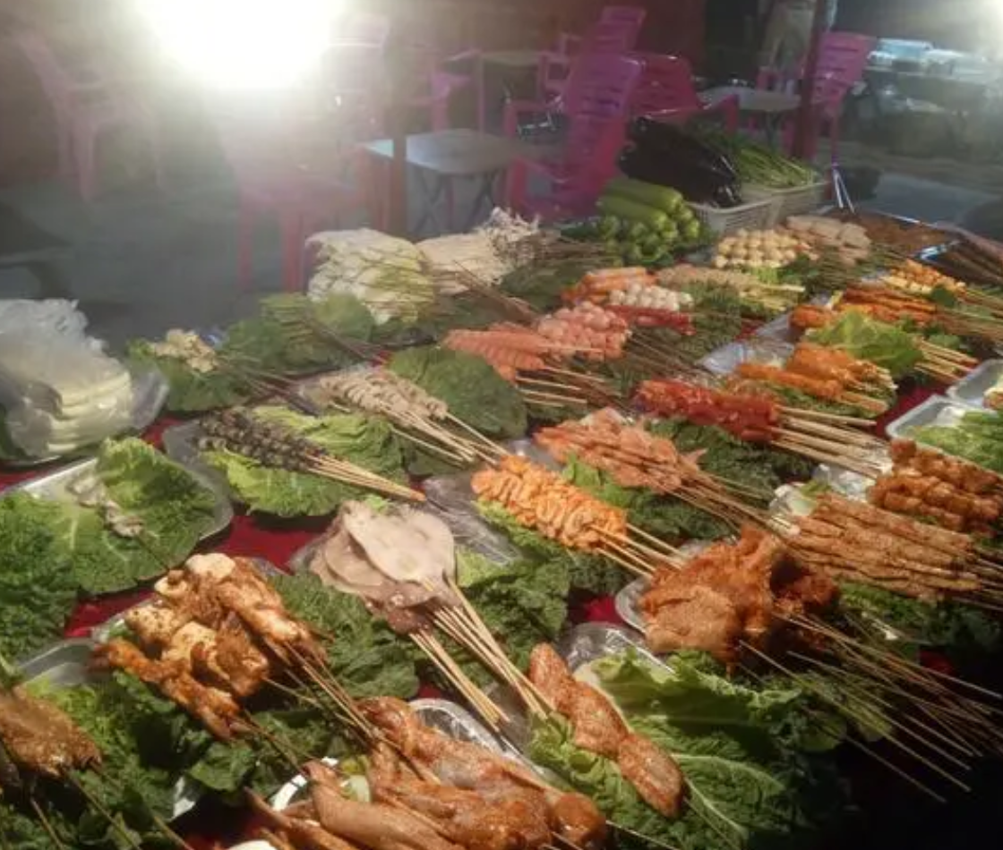
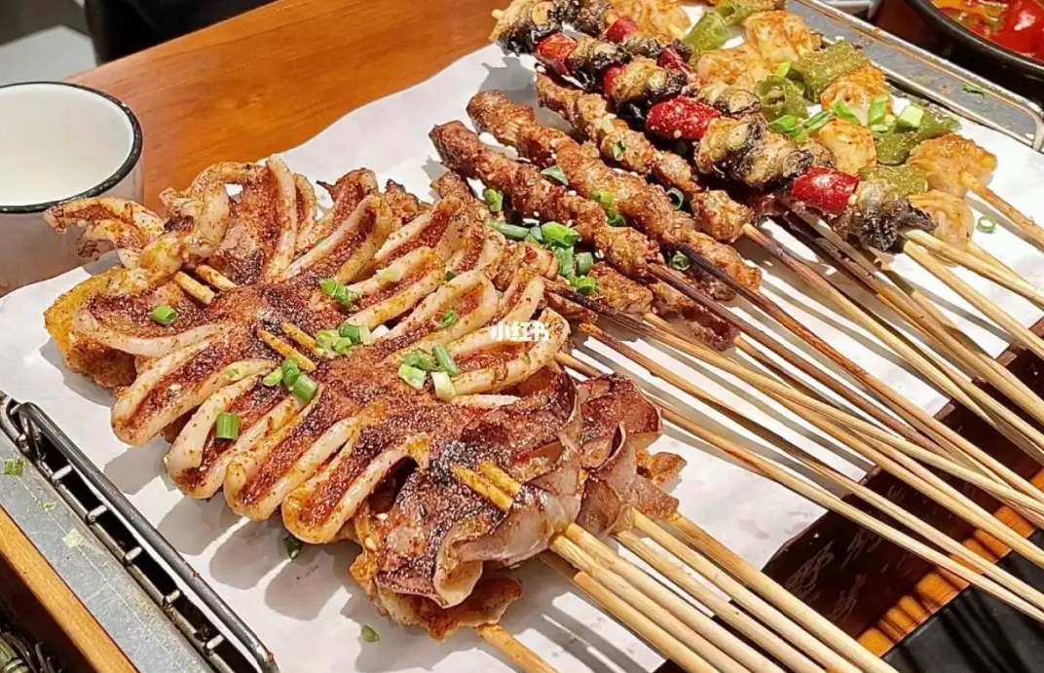
Barbecue
Barbecue is a trendy food in China, especially at midnight.
Rather expensive.
A freezing cold drink is necessary when having it.

Slide 8
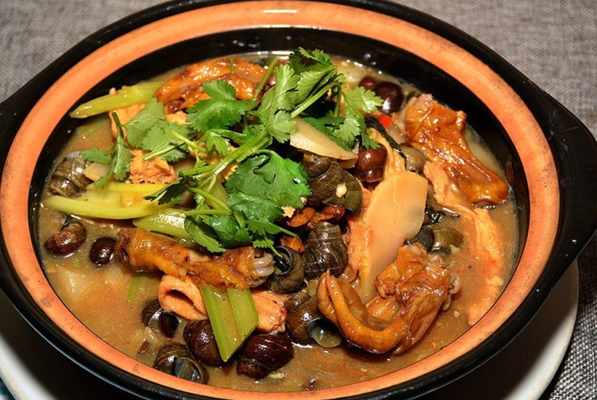
Snail Duck’s feet pot(田螺鸭脚煲)
Another specialty in Guangxi
Along with barbecue in night snack restaurant.

Slide 9
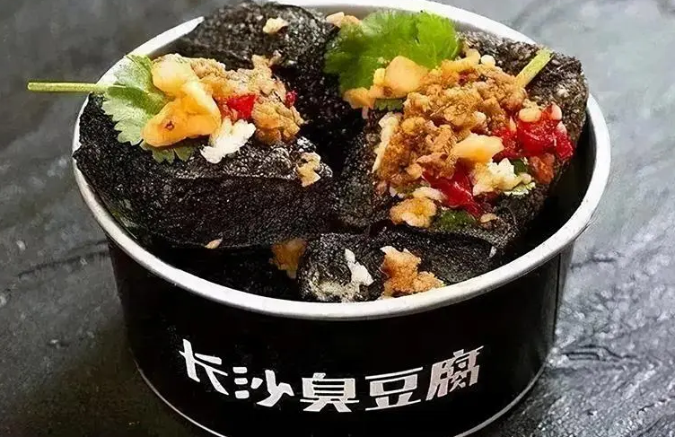
Stinky Tofu
A snack everywhere on streets usually at night.
A rather cheap snack.

Slide 10
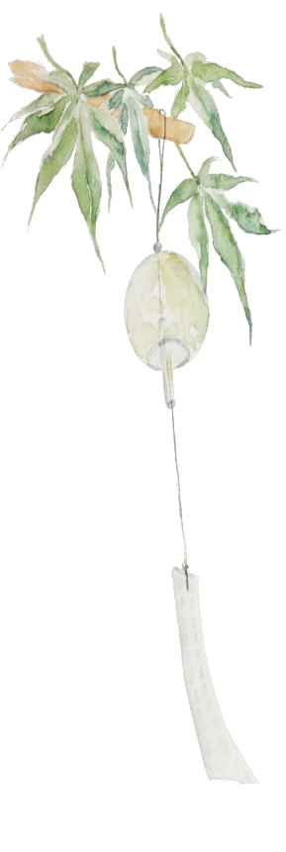
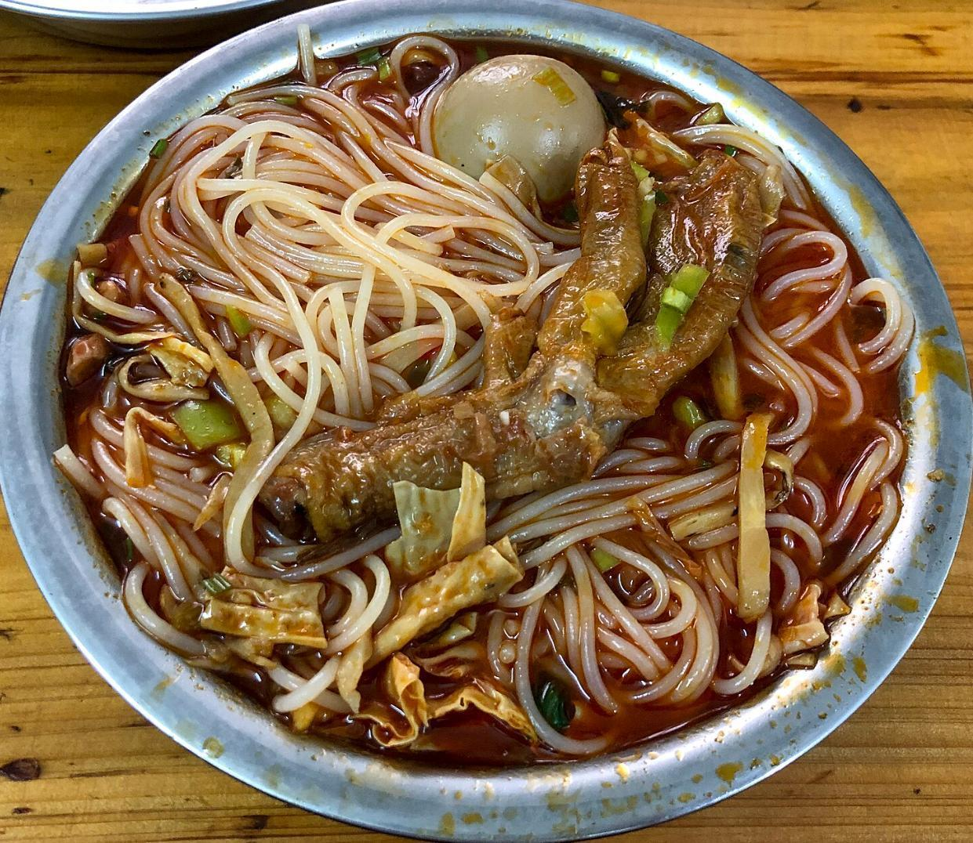
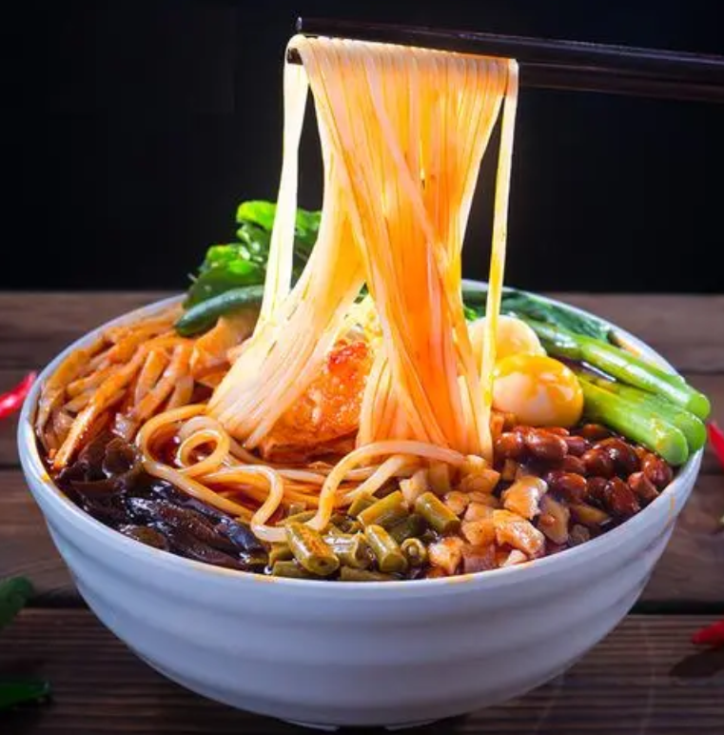
Which one do you think is more palatable?

Slide 11
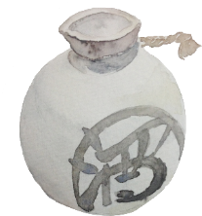
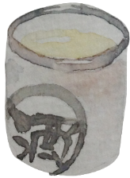
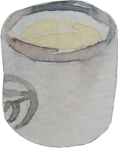
Food with extra parts
In modern reality, we don’t just consume the foods themselves, but also the symbols attached to them.
壹
The more expensive the foods are, the purest symbols we consume.
贰
When a rich consumes a deluxe delicacy, even it tastes like a piece of shit, is delicious.
叁

Slide 12
What are your favorite foods?

